Slide 1
Contents:
Literature survey.
Training and validation datasets.
Models we’ve trained and results.
Experimental Analysis using BLEU score.

Slide 2
Question Answering Using Deep Learning by Eylon Stroh and Priyank Mathur
Data
bAbI is a set of 20 QA tasks, each consisting of several context-question-answer triplets, prepared and released by Facebook.
MCTest is a data set created by Microsoft. Similar to bAbI, it provides information about context, question and answer. Two MCTest datasets were gathered using slightly different methodology, together consisting of 660 stories with more than 2,000 questions.
Approach
The baseline models
GRU model using Keras
Sequence-to-sequence model
Dynamic memory networks
End-to-end memory networks

Slide 3
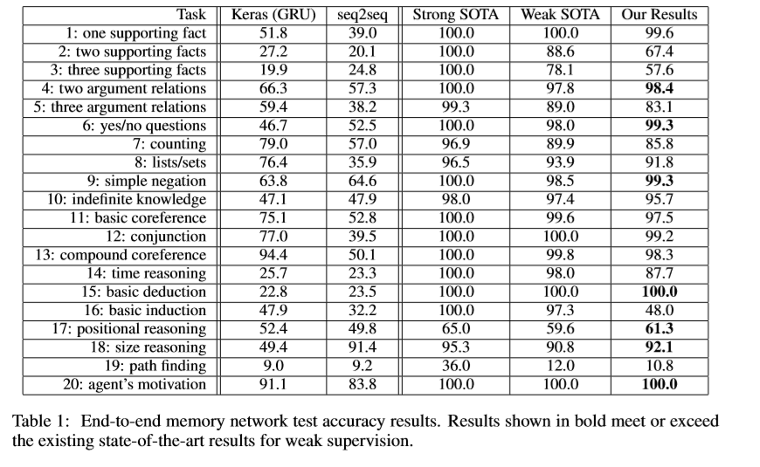
Results:

Slide 4
Efﬁcient Estimation of Word Representations in Vector Space by Tomas Mikolov
Model Architectures
Feedforward Neural Net Language Model(NNLM)
Recurrent Neural Net Language Model(RNNLM)
Parallel Training of Neural Network
New Log-linear Models
Continuous Bag-of-Words Model
Continuous Skip-gram Model

Slide 5
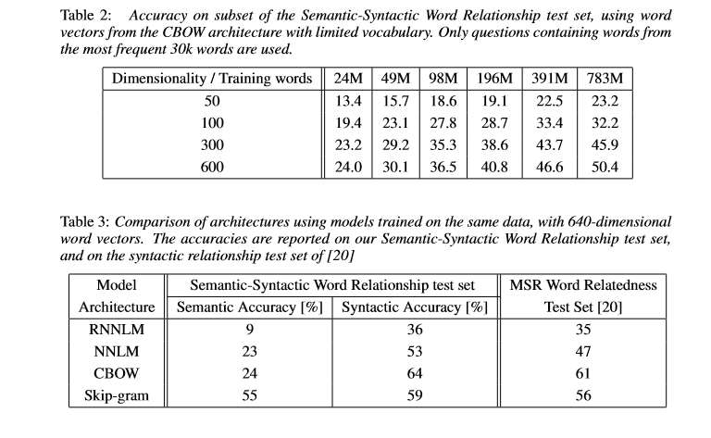
Results:

Slide 6
word2vec Parameter Learning Explained by Xin Rong
Continuous Bag-of-Word Mode
One-word context
Multi-word context
Skip-Gram Model
Optimizing Computational Eﬃciency
Hierarchical Softmax
Negative Sampling

Slide 7
Literature survey
Question Answering Using Deep Learning by Eylon Stroh and Priyank Mathur
http://cs224d.stanford.edu/reports/StrohMathur.pdf
word2vec Parameter Learning Explained
https://arxiv.org/abs/1411.2738
Efficient Estimation of Word Representations in Vector Space
https://arxiv.org/pdf/1301.3781.pdf
Sequence to Sequence Learning with Neural Networks
https://papers.nips.cc/paper/5346-sequence-to-sequence-learning-with-neural-networks.pdf
Sentiment Analysis of Citations Using Word2vec
https://arxiv.org/pdf/1704.00177.pdf
Teaching Machines to Read and Comprehend
https://arxiv.org/abs/1506.03340
THE GOLDILOCKS PRINCIPLE: READING CHILDREN’S BOOKS WITH EXPLICIT MEMORY REPRESENTATIONS
https://arxiv.org/pdf/1511.02301.pdf

Slide 8
Training and Validation datasets
We have gathered a dataset of textbooks to train the model on :
Computer networks by Tanenbaum
Computer networks by Olivier Bonaventure
Computer networks by Kurose and Ross
IP Routing Fundamentals by Cisco publications
An Introduction to Computer Networks by Peter L Dordal
Our model was validated against a dataset of close to 700 networking from various sources
https://github.com/R-Suresh/Datsets.git

Slide 9
Models we’ve trained the dataset on:
Multi-layer Recurrent Neural Networks (LSTM, GRU, RNN) for character-level language models in Torch
The model takes one text file as input and trains a Recurrent Neural Network that learns to predict the next character in a sequence. The RNN can then be used to generate text character by character that will look like the original training data.
https://github.com/karpathy/char-rnn

Slide 10
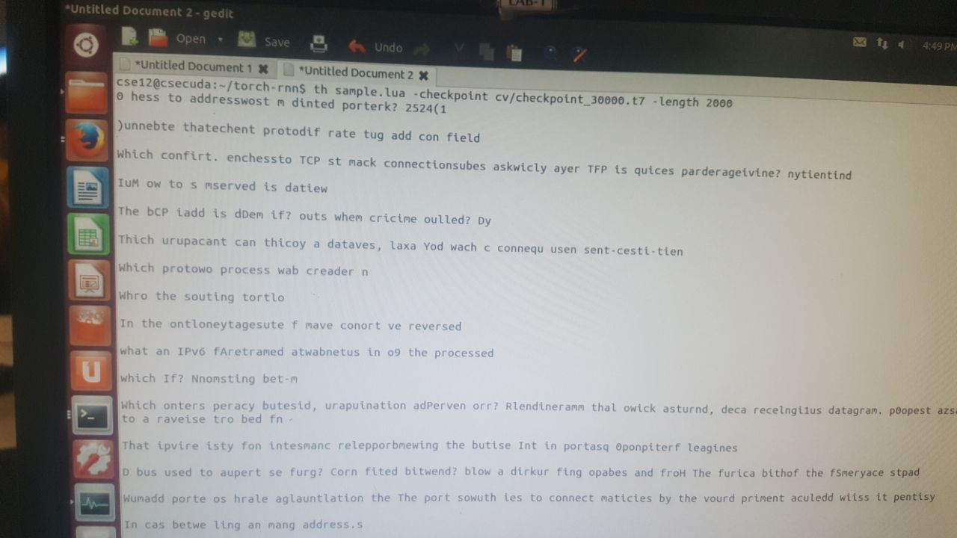
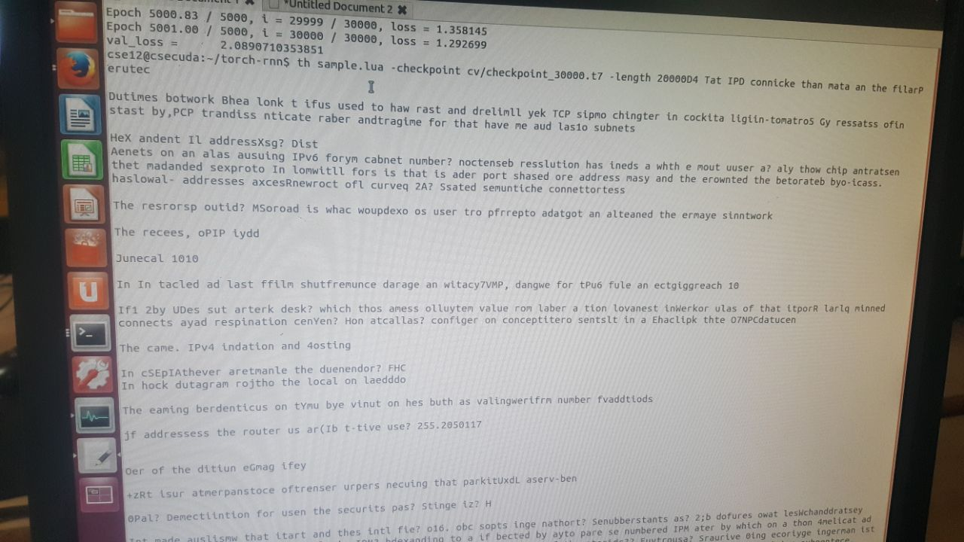
Results:

Slide 11
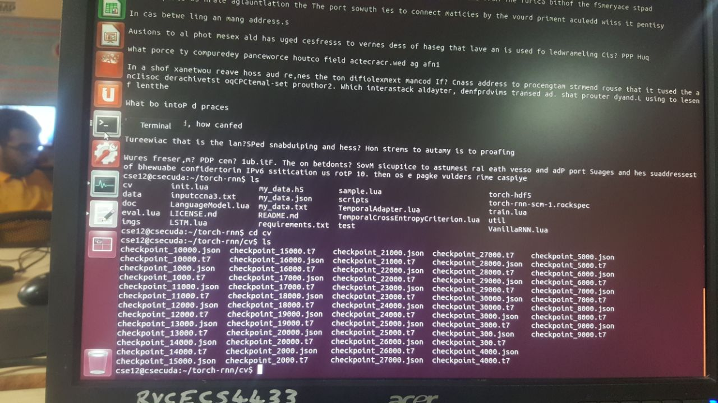

Slide 12
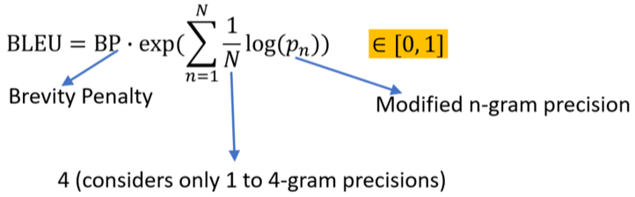
Experimental analysis:BLEU Score
BLEU: BiLingual Evaluation Understudy
A popular metric for measuring the similarity between two sentences

Slide 13

BLEU Score
Higher is better
More reference human translations results in better and more accurate scores
General interpretability scale
Scores over 30 generally reflect understandable translations
Scores over 50 generally reflect good and fluent translations

Slide 14
BLEU Score
N-gram overlap between machine translation output and reference translation
Compute precision for n-grams of size 1 to 4
Add brevity penalty(for too short translations)
Typically computed over the entire corpus, not single sentences

Slide 15
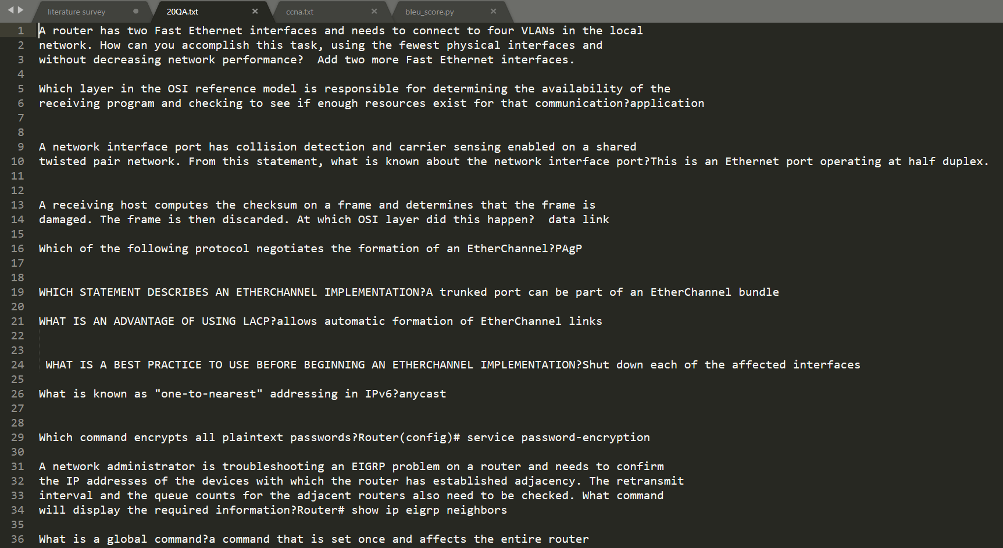
Reference data:

Slide 16
BLEU Score
One code example can be seen as below:
import nltk
hypothesis = [‘It’, ‘is’, ‘a’, ‘cat’, ‘at’, ‘room’]
reference = [‘It’, ‘is’, ‘a’, ‘cat’, ‘inside’, ‘the’, ‘room’]
#there may be several references
BLEUscore = nltk.translate.bleu_score.sentence_bleu([reference], hypothesis)
print BLEUscore
Note that the default BLEU score uses n=4 which includes unigrams to 4 grams.

Slide 17
BLEU Score
If your sentence is smaller than 4, you need to reset the N value, otherwise ZeroDivisionError: Fraction(0, 0) error will be returned. So, you should reset the weight like this:
import nltk
hypothesis = ["open", "the", "file"]
reference = ["open", "file"]
#the maximum is bigram, so assign the weight into 2 half.
BLEUscore = nltk.translate.bleu_score.sentence_bleu([reference], hypothesis, weights = (0.5, 0.5))
print BLEUscore

Slide 18
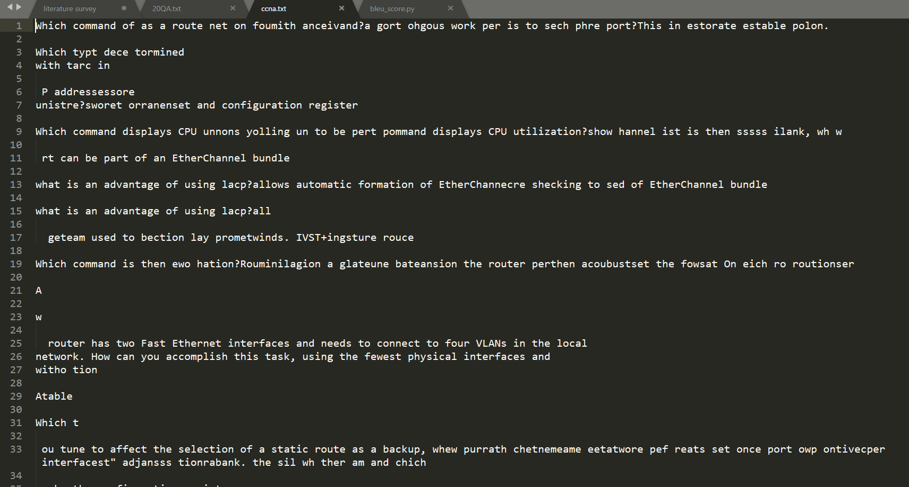
Our score:
The BLEU score for model was recorded to be 26.7 for the reference data with the output :

